Slide 1

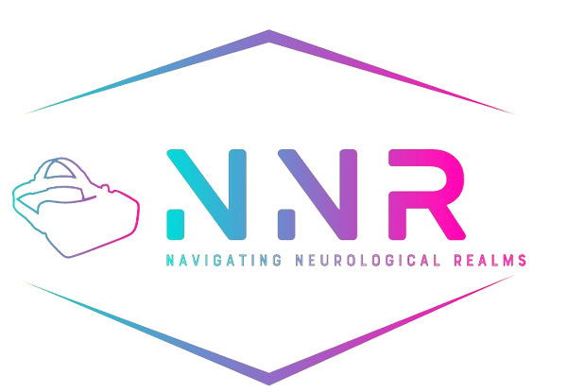
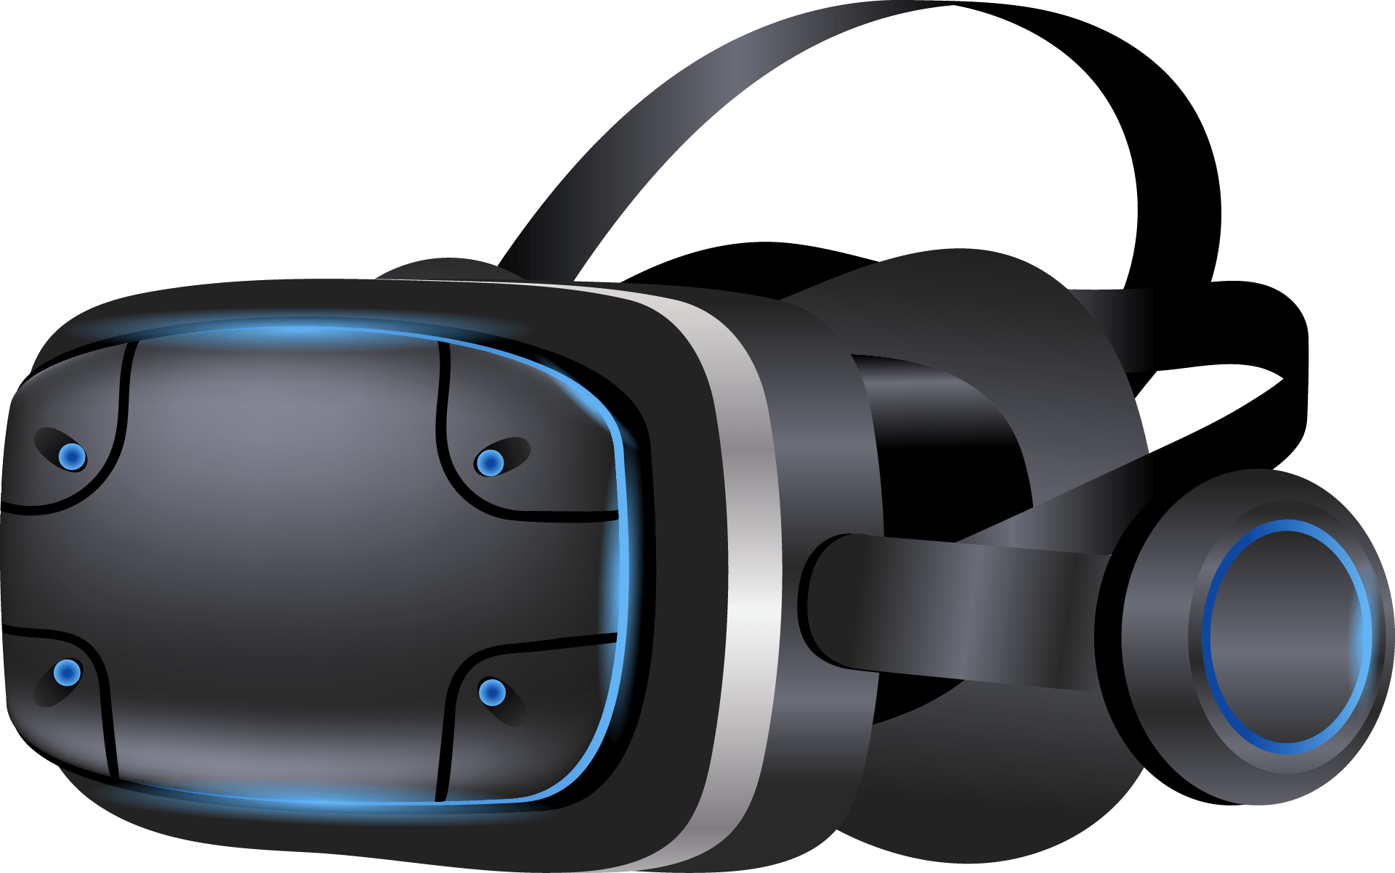
Capstone Project Phase A
24-1-D-28
Students:
Michael Malka 311446231
Nir Asulin 305221483
Supervisors:
Dr. Anat Dahan
Dr. Marcela Viviana Karpuj

Slide 2

Introduction
Parkinson's disease (PD) is a neurodegenerative disorder affecting millions worldwide.
Characterized by symptoms such as tremors, slowness , stiffness of movement, and postural instability.
Early diagnosis is challenging due to subtle and variable early-stage symptoms.
Our project leverages VR technology for early PD detection by identifying specific motor and cognitive impairments.

Slide 3

Motivation
01
03
02
Enhance early diagnostic accuracy.
Improve patient experience in diagnostic experiences and compliance.
Enhancing Neurological Healthcare through Technology.
04
Potential for use in other neurological diagnostics and rehabilitation.

Slide 4
Analysis of the Problem
Motor Asymmetry in PD
Existing Solutions
DaTSCAN FDA-approved imaging for visualizing dopamine system changes.
MDS-UPDRS Scale for assessing motor and non-motor symptoms, needing precise tools.
VR Corridor for FoG Uses VR to study freezing of gait in PD patients.
DiagnaMed VR/AI Neuro System Combines VR and AI for remote diagnosis.
Cleveland Clinic’s VR Shopping Platform Uses VR and treadmill to assess daily activities.
Motor asymmetry is a defining characteristic of PD, evident from disease onset.
Patients exhibit more severe symptoms on one side due to uneven neuronal degeneration in the substantia nigra.
Current Gaps
Lack of extensive knowledge and tools leveraging VR for early PD diagnosis.
Current diagnostic methods are not sufficiently precise for early detection.

Slide 5
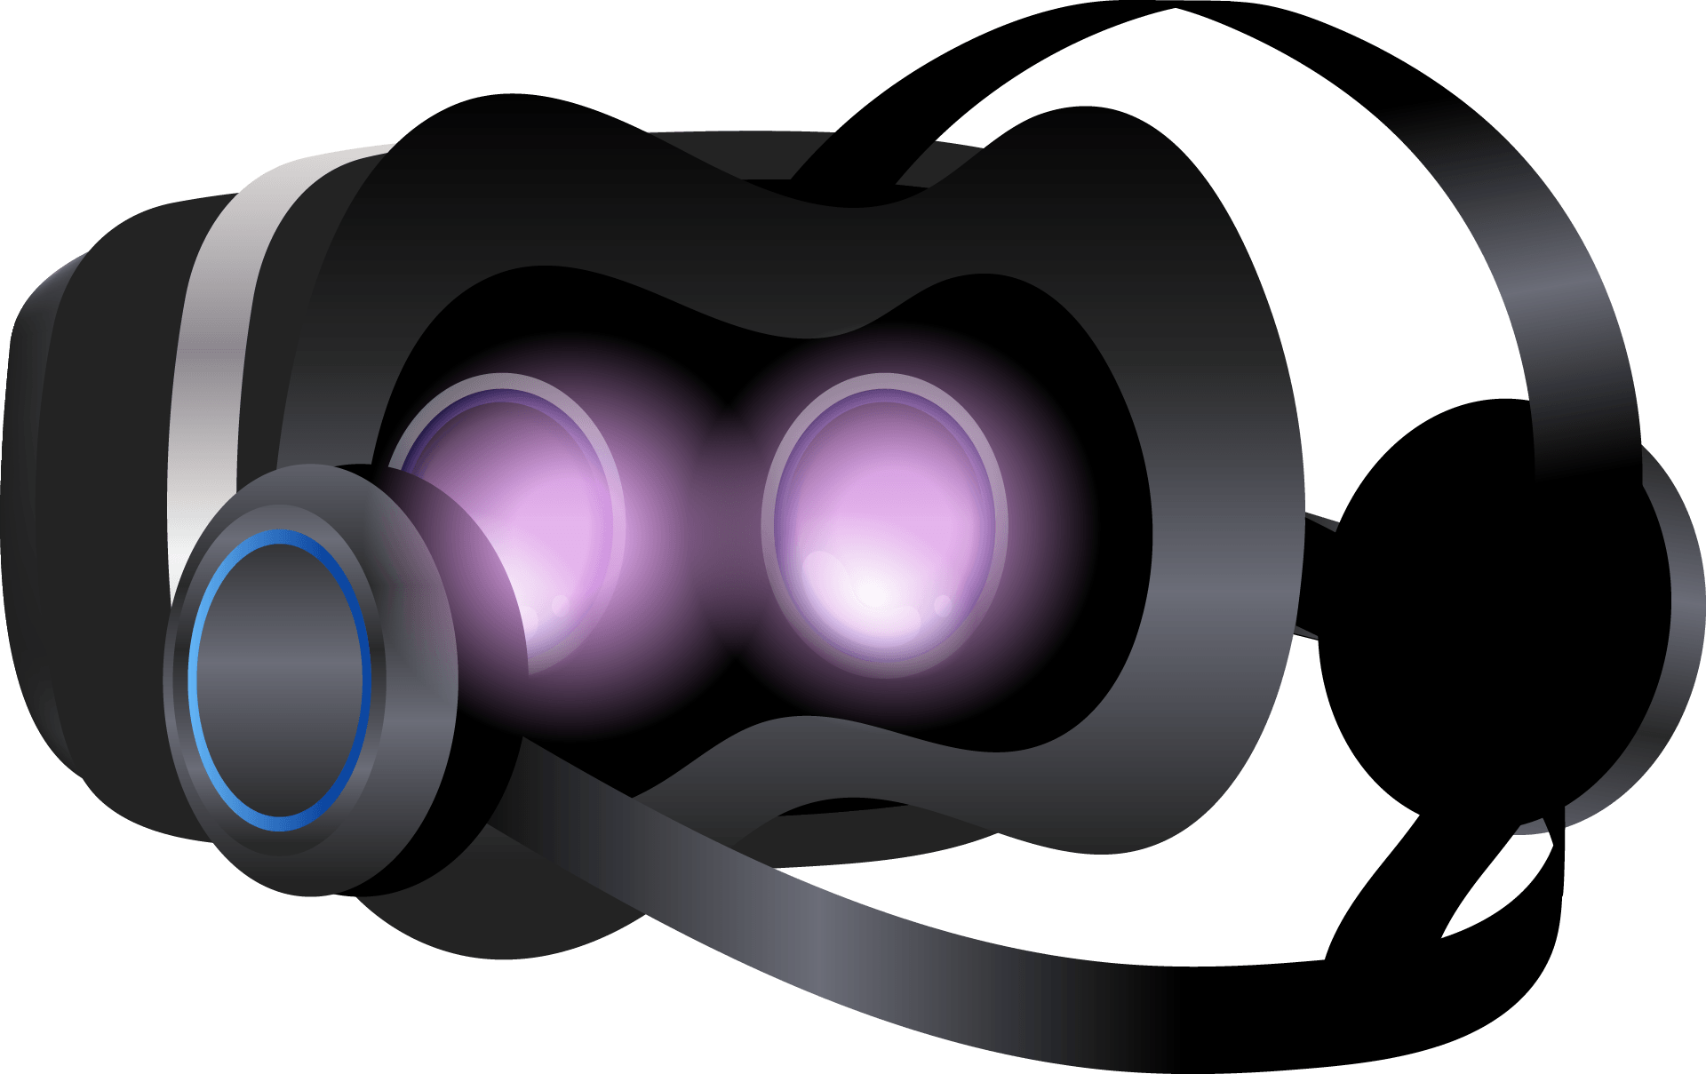
Our Solution
VR-Based Detection
VR system tracks user movements, detecting asymmetries indicative of early PD.
Simulates swimming tasks using the Oculus Quest 2 and Unity engine.
Records data in CSV format for detailed analysis.

Slide 6
Engineering Development Process
Research
Extensive research on PD and existing diagnostic methods.
Our solution integrates advanced VR technology to identify early-stage motor and cognitive impairments.
Development Phases
Define system needs and target users.
Create detailed plans and prototypes.
Build the system using Unity and Oculus Quest 2, integrate motion tracking.
Validate with user testing, ensure accuracy in movement tracking and asymmetry detection.

Slide 7
Why Asymmetry?
Our project supervisor Marcella told us a story about her close friend that was early detected with PD.
Patients often experience more severe symptoms on one side of the body ➔ result from uneven degeneration of neurons in the substantia nigra.
Motor asymmetry is a defining characteristic of PD, often evident from the disease's onset.
Clinical Relevance: Helps in differentiation of PD from other neurological conditions with symmetrical motor impairments.
Persistent Nature: Motor symptoms in PD remain asymmetric over time, making it reliable for monitoring disease progression.

Slide 8

Why Unity?
Intuitive interface and extensive support for VR development.
Supports a wide range of media assets and platforms.
Strong set of tools for motion tracking and 3D environment creation.

Slide 9
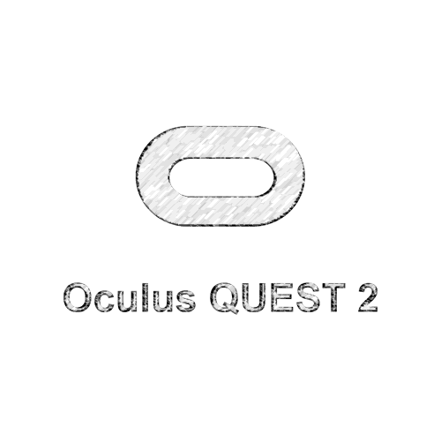
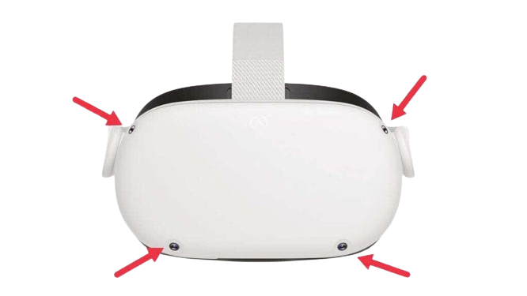
Why Oculus Quest 2?
Precise hand and motion tracking essential for detecting subtle asymmetries.
High-resolution display and interactive capabilities without external sensors.
Utilizes advanced computer vision algorithms and SLAM techniques.

Slide 10
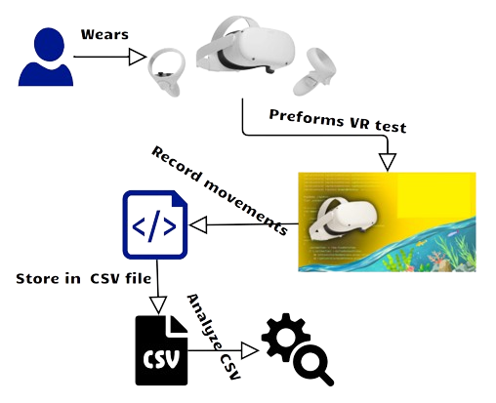
Architecture diagram

Slide 11
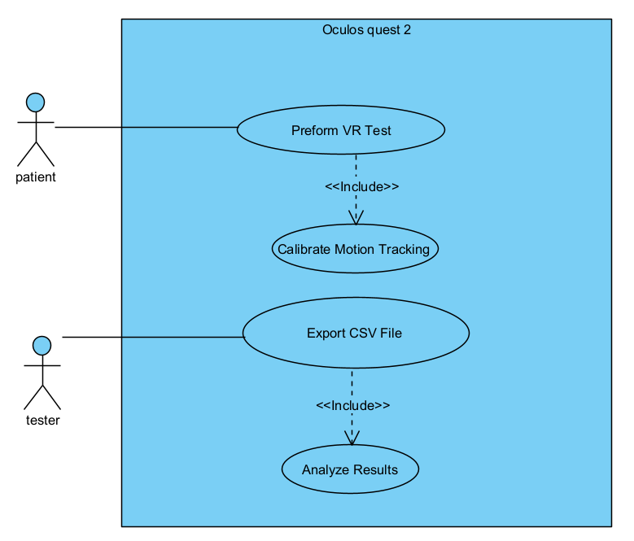
Use-Case diagram

Slide 12
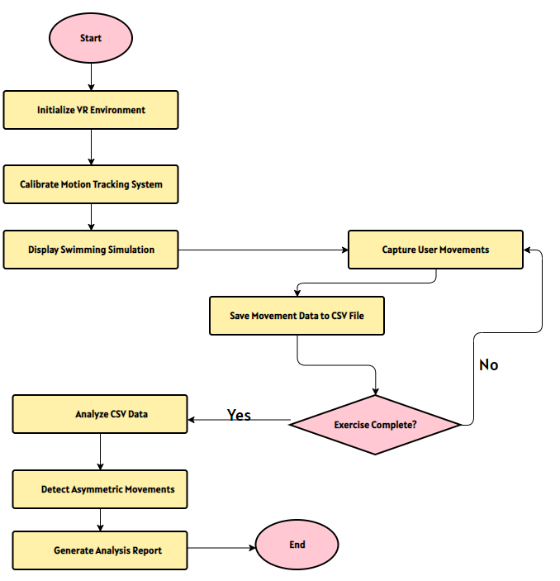
Flowchart diagram

Slide 13

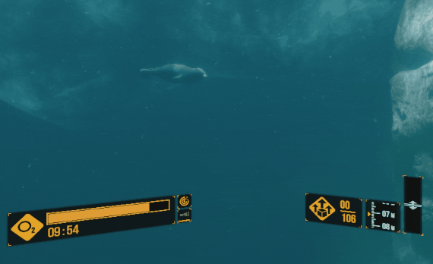
Illustration

Slide 14
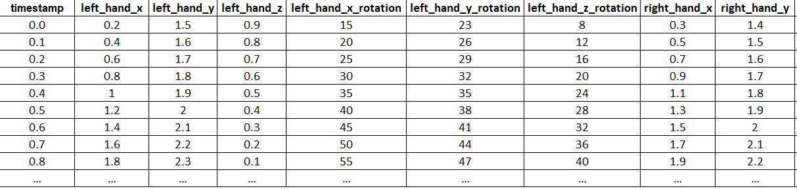
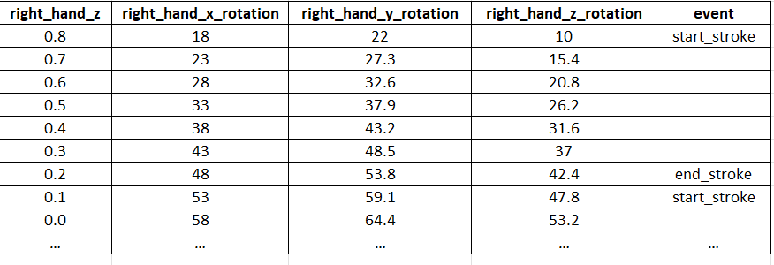
CSV file exmple

Slide 15
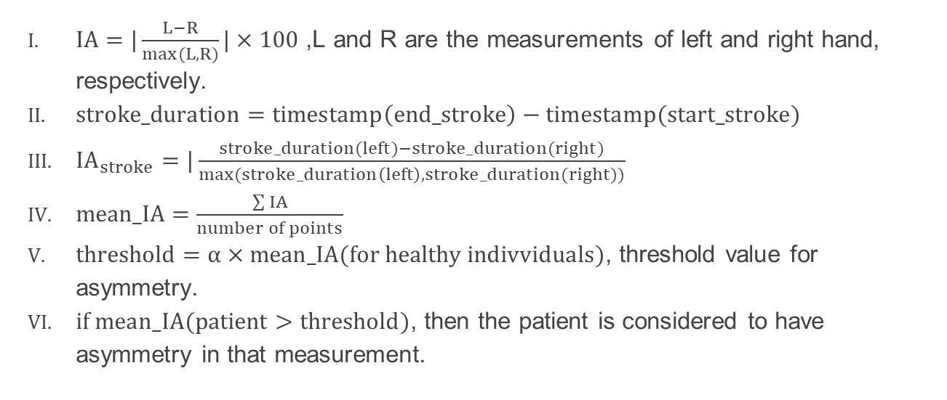
CSV file analysis algorithm
$IA=|\frac{L−R}{max⁡(L,R)}|×100$ ,L and R are the measurements of left and right hand, respectively.
$stroke_duration=timestamp\left(end_stroke\right)−timestamp(start_stroke)$
${IA}_{stroke}=|\frac{stroke_duration(left)−stroke_duration(right)}{max⁡(stroke_duration\left(left\right),stroke_duration(right))}$
$mean_IA=\frac{\sum{IA}}{number of points}$
$threshold=α×mean_IA(for healthy indivviduals)$, threshold value for asymmetry.
$if mean_IA(patient>threshold)$, then the patient is considered to have asymmetry in that measurement.

Slide 16
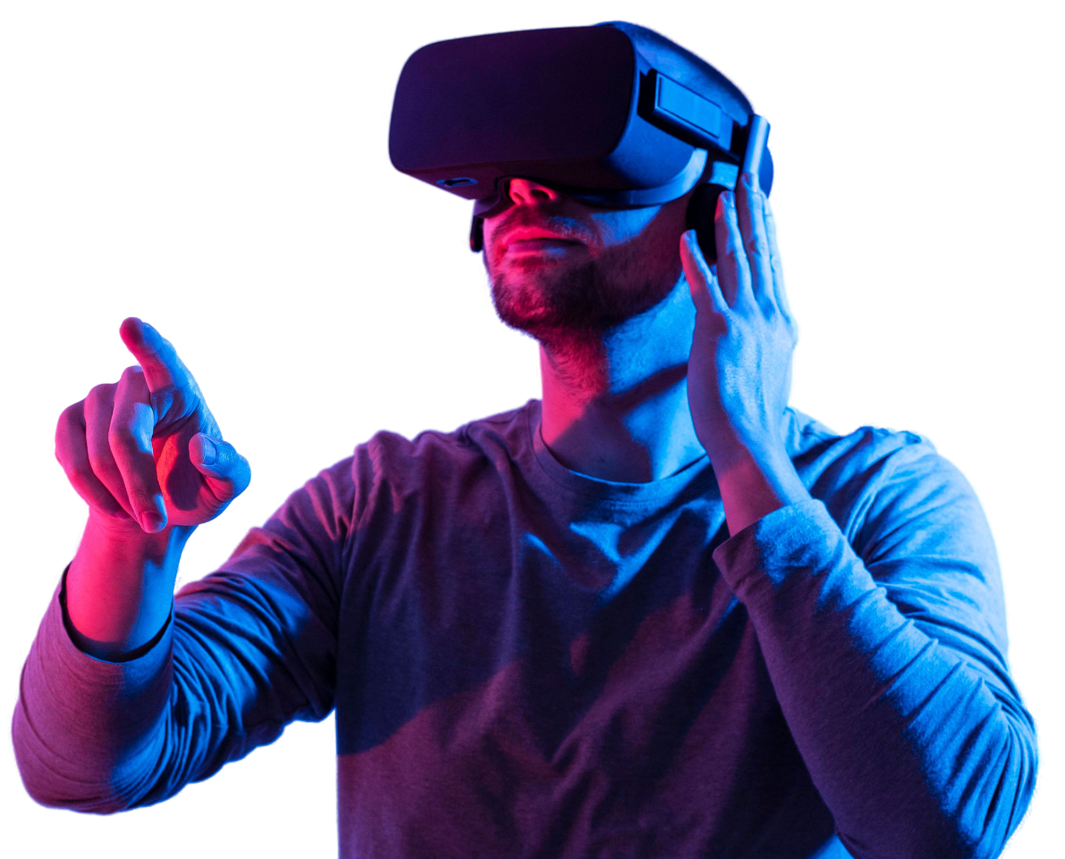

Contribution
Market Impact
Enhances early diagnosis rates and improves patient outcomes.
Innovation
First use of VR for early PD detection using swimming tasks.

Slide 17
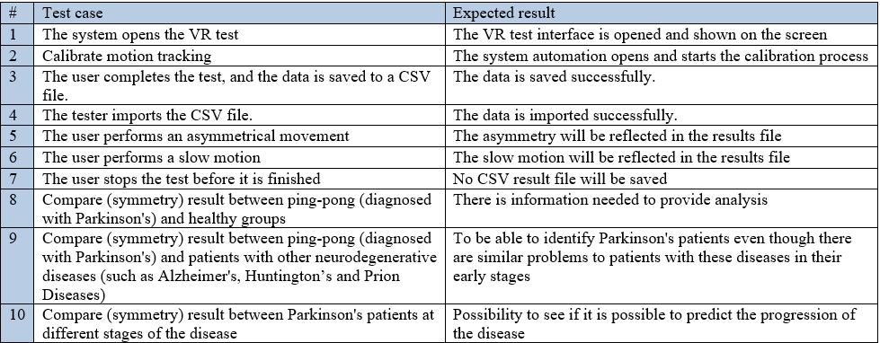
Tests Table

Slide 18

Expected Challenges
Technical
User Acceptance
Ensuring accurate motion tracking and data analysis.
Find PD diagnosed volunteers for our test to collect the data.

Slide 19
Thank you for your attention
Do you have any questions?

